Slide 1
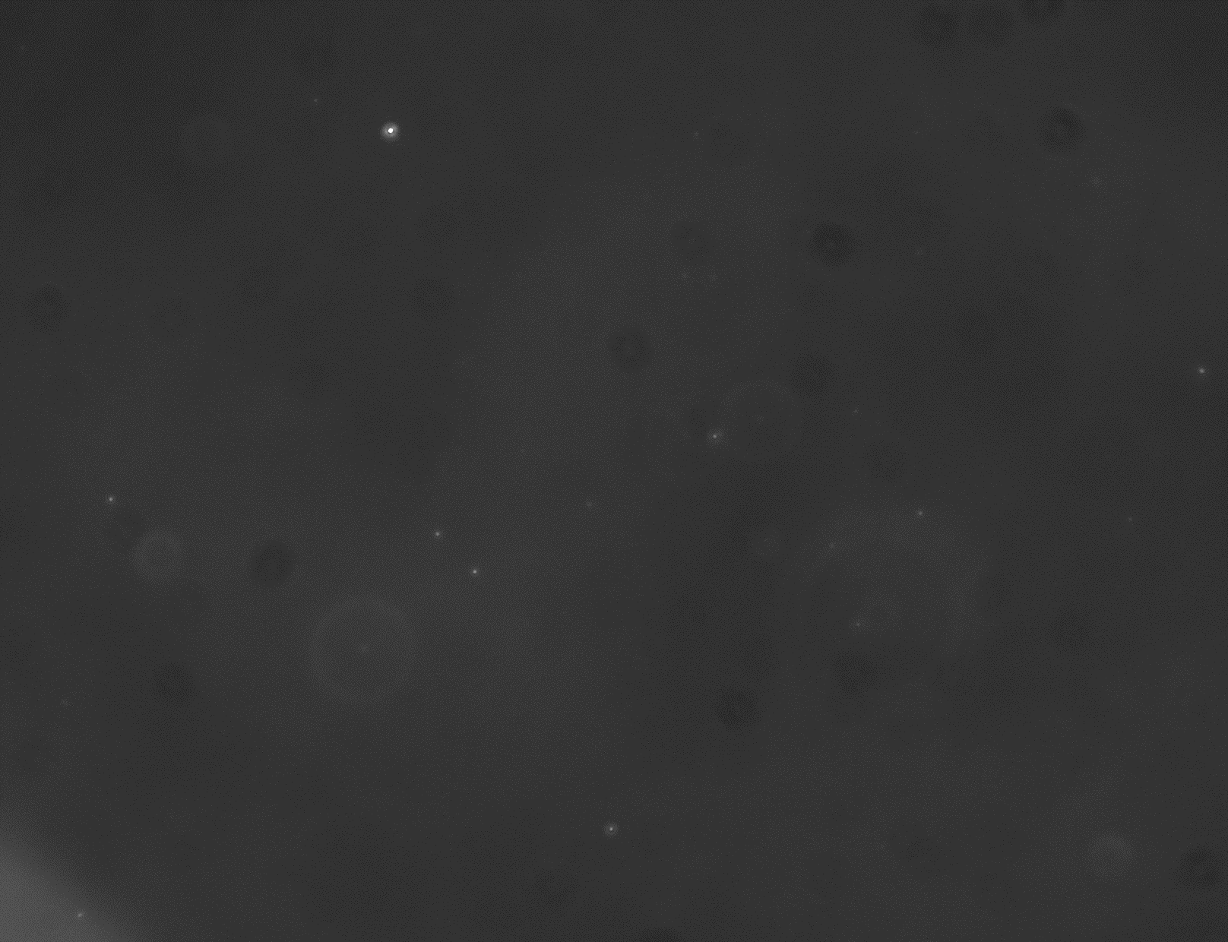
30.6 nm
0 sec
50 μm

Slide 2
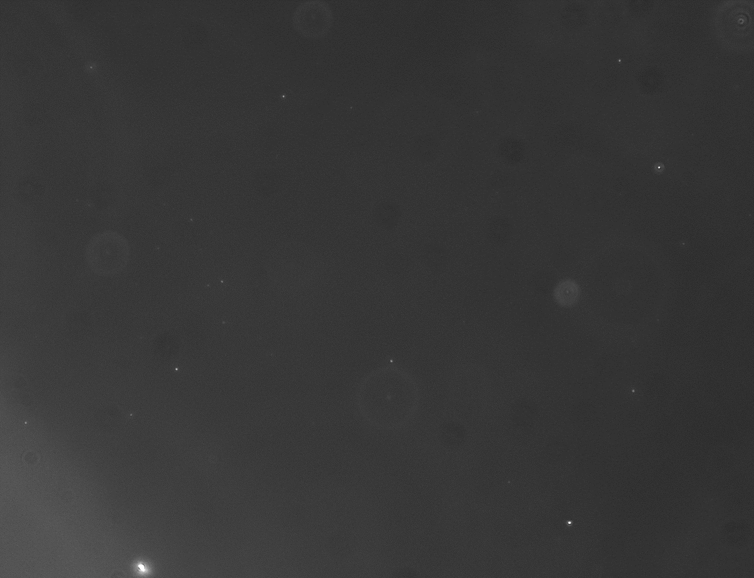
42.7nm
0 sec
50 μm

Slide 3
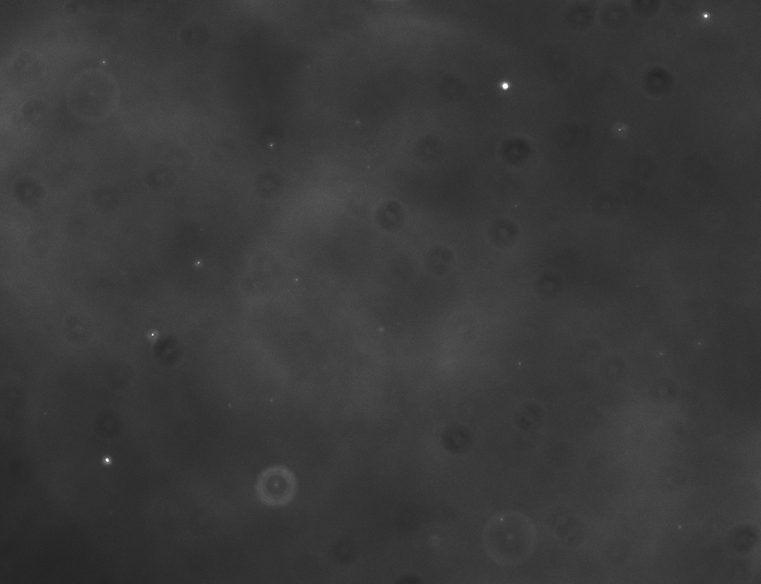
45.3 nm
0 sec
50 μm

Slide 4
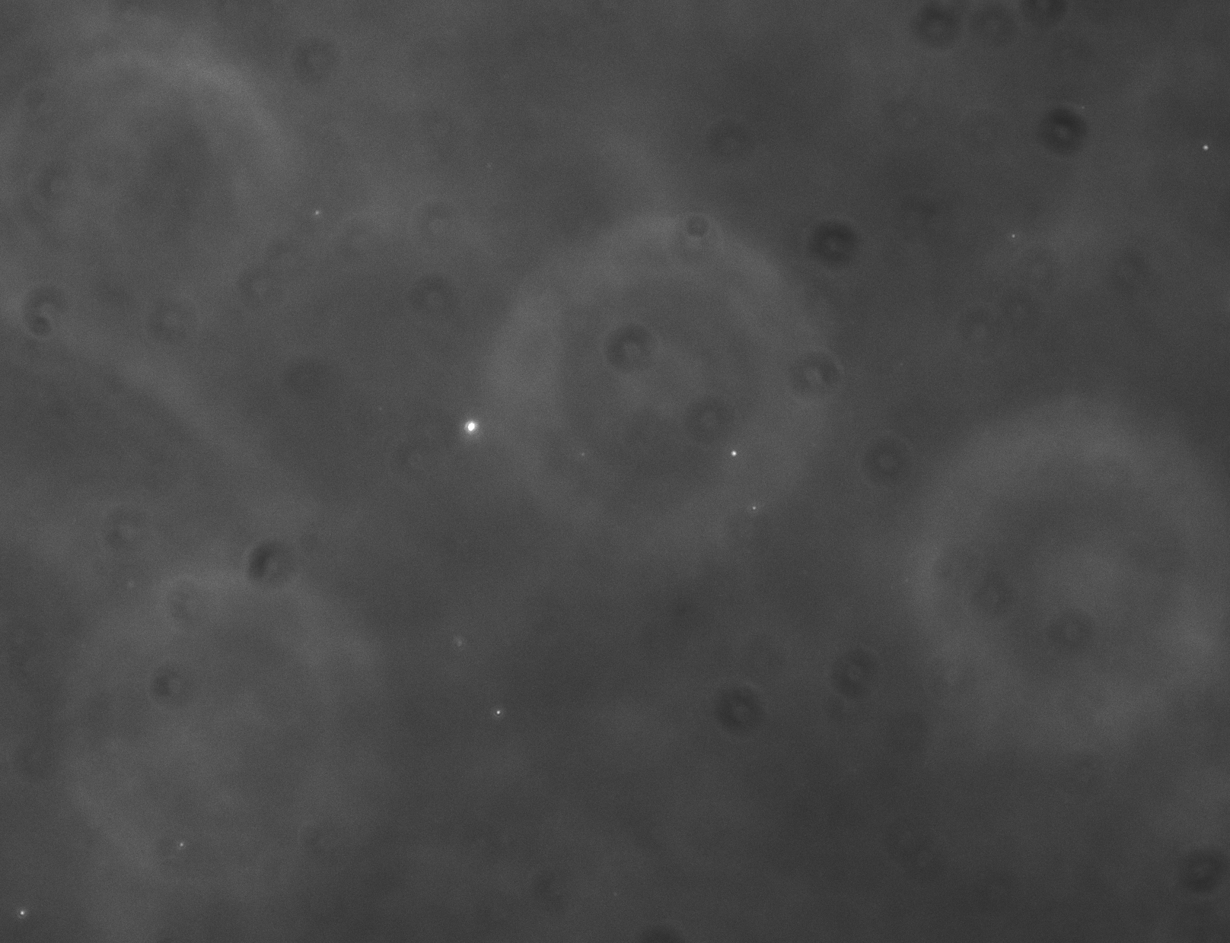
52.5 nm
0 sec
50 μm

Slide 5
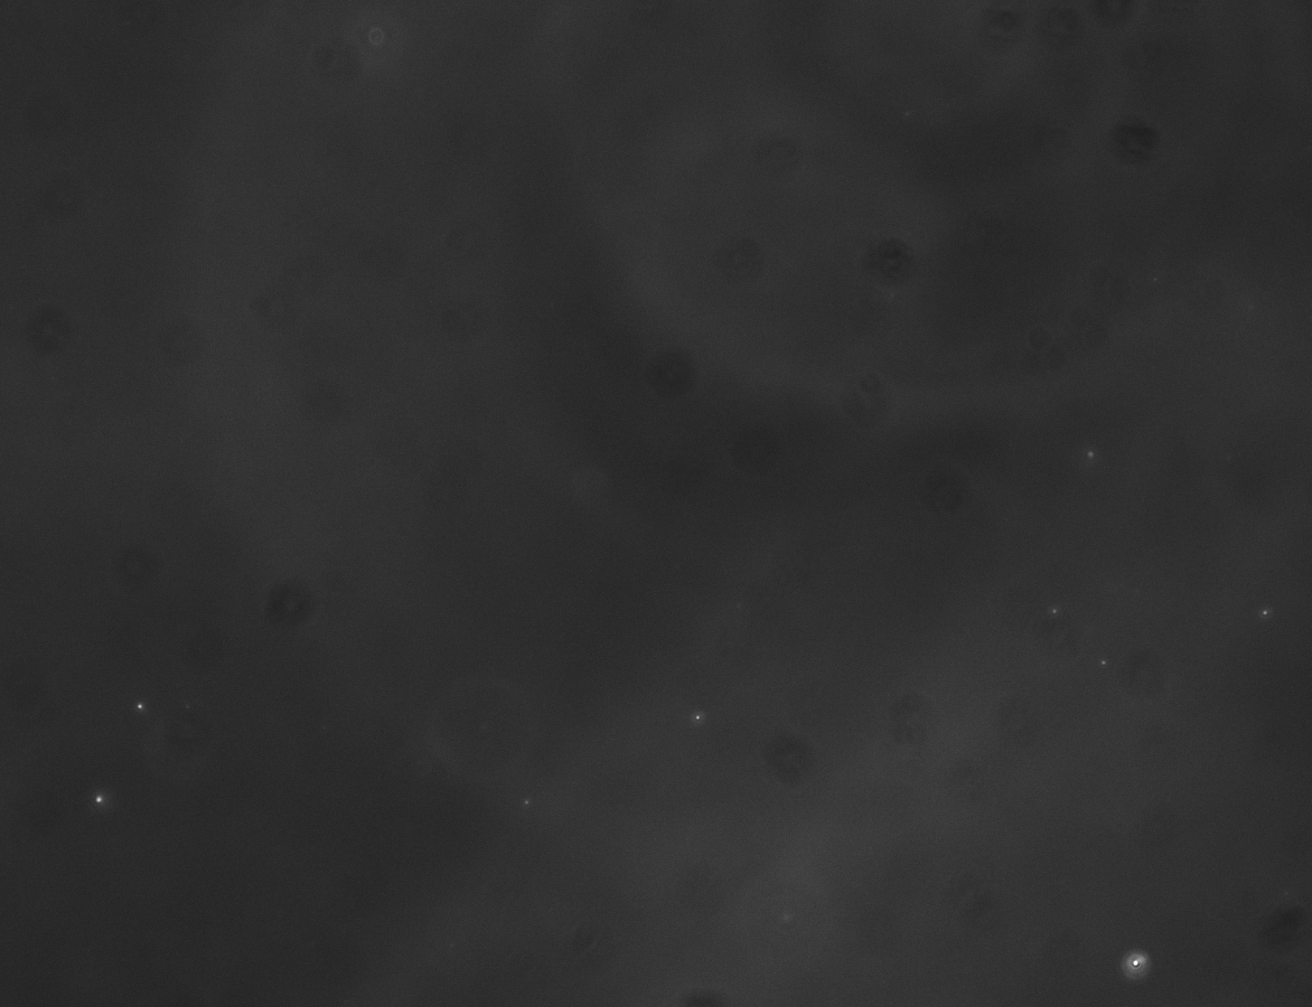
55.8 nm
0 sec
50 μm

Slide 6
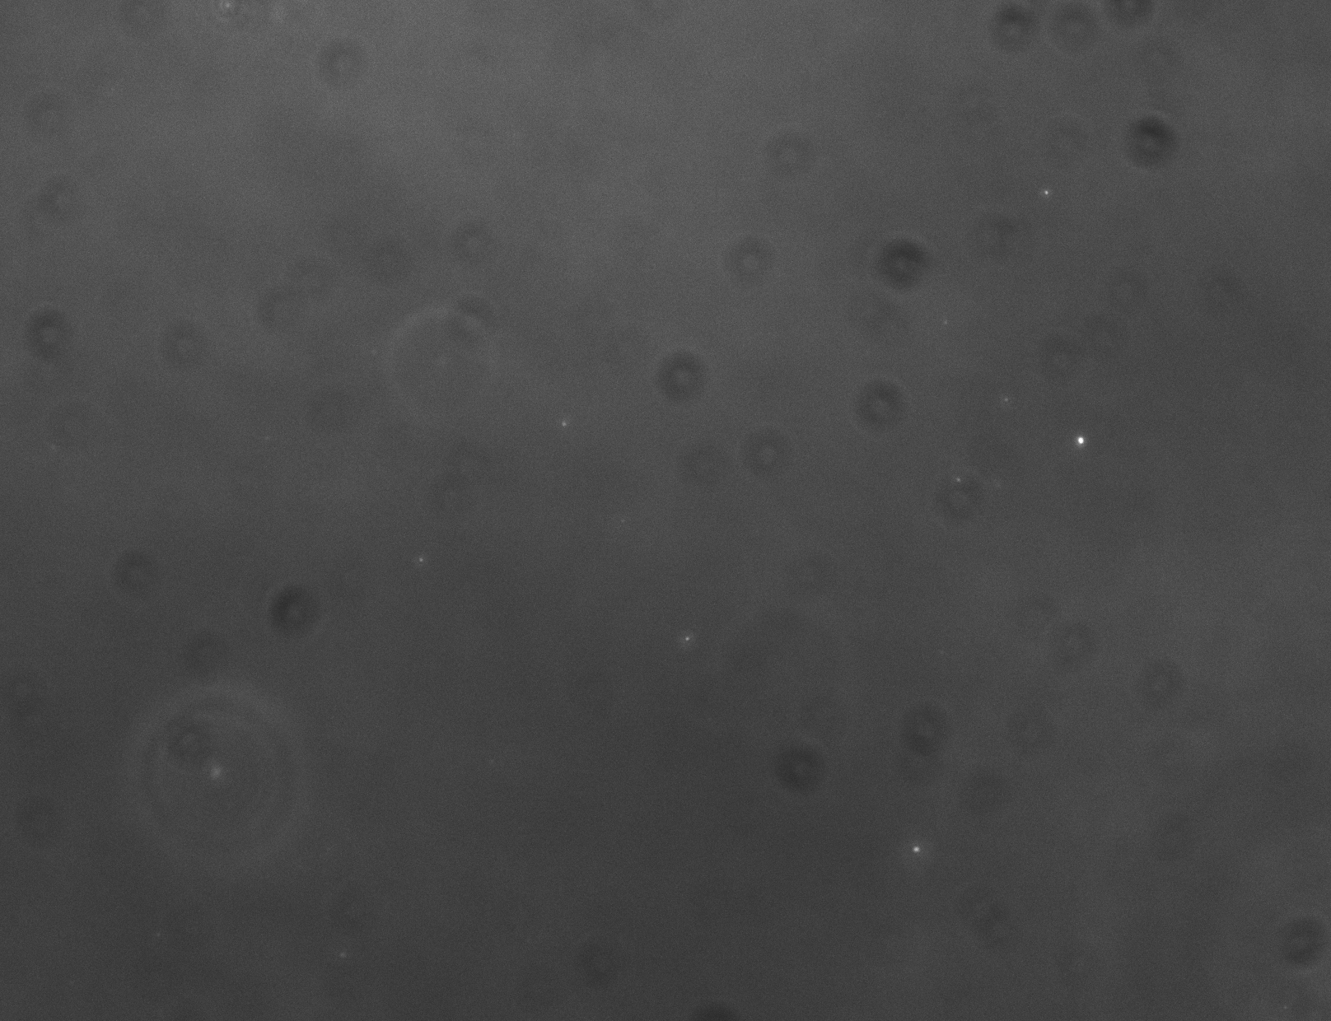
61.4 nm
0 sec
50 μm

